Slide 1
Tornadoes : A Force of Nature
Project Group 6

Slide 2
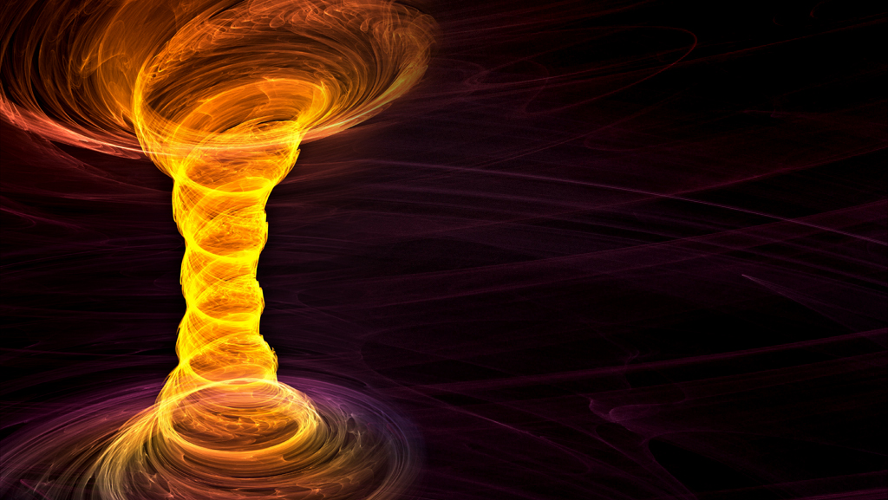
Group Members
Richard Malolepszy
Gavin Wan
Priya Maringanti
Shankar Mohanathas

Slide 3
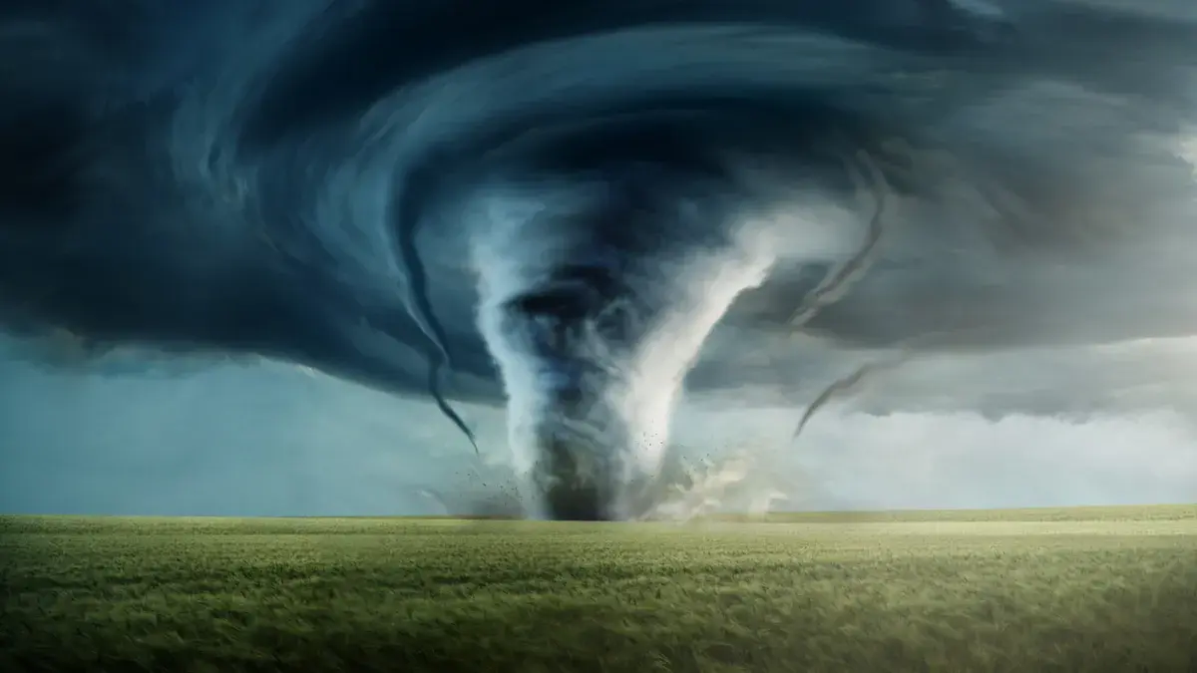
What is a Tornado?
A violently rotating column of air touching the ground
Found usually at the base of a thunderstorm

Slide 4
Tornadoes in the USA
Our Pitch!

Slide 5
Thought Process
Exploring DATA to find what is important to our topic of Tornadoes.
Extracting the:
WHERE,
WHEN,
WHAT,
HOW.
Coding in JS to Visualize the most efficient communication method using LEAFLET, DS, HTML.
Testing EVERY step of coding. Testing for EASE of USE along the way.
Being Happy with a Final Product for the END USER.

Slide 6
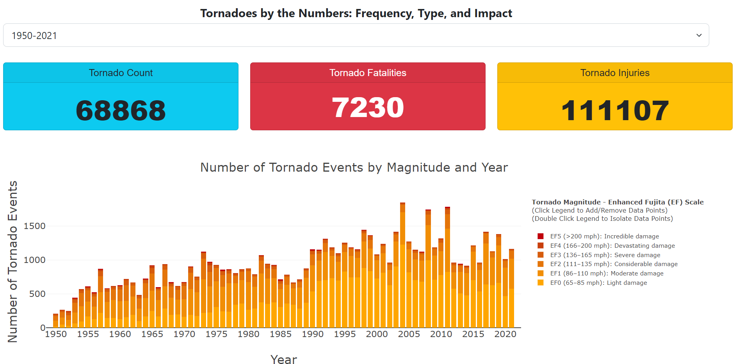

Slide 7
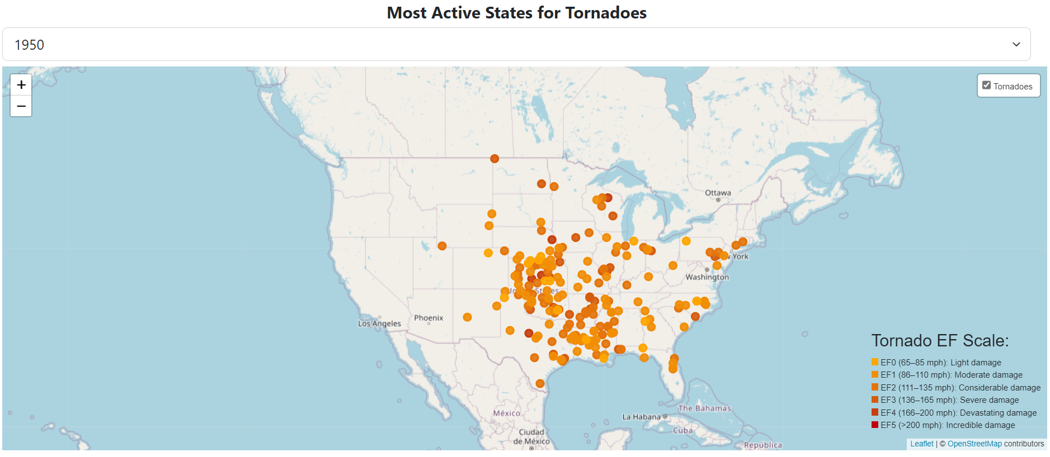

Slide 8
Charting Distributions of States and Months

Slide 9

Limitations
Knowledge
Approach
Information availability

Slide 10
Conclusions and Connections
Average Person
Planning a Vacation
Buying a house
Big Picture
Business Planning
Public Safety and Emergency Response
Urban Planning

Slide 11
QUESTIONS?

